Slide 1


Tree-based Ensemble models : LightGBM
2020. 11. 13.

Slide 2
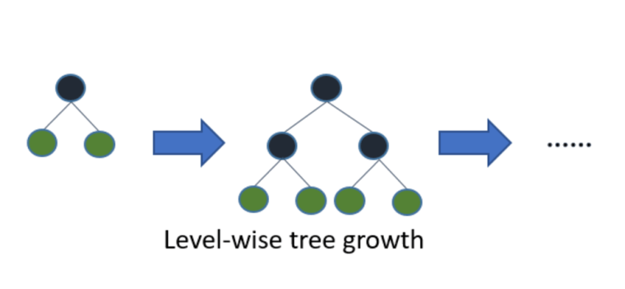

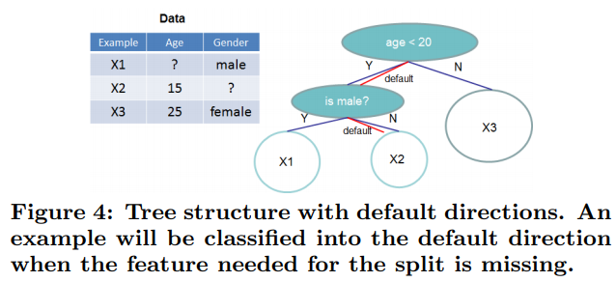
Gradient Boosting Decision Tree (GBDT)
Popular Algorithms : XGBoost
Level-wise tree growth
Issue #1. How to split?
Diverge toward greater gain based on total similarity
Create branch points for all leaf nodes
Branching stops when the gain is negative in all conditions
Additive tree computes the mean of the residuals
Issue #2. How to handle the “sparse” data?
Sparsity-aware Split Finding

Slide 3
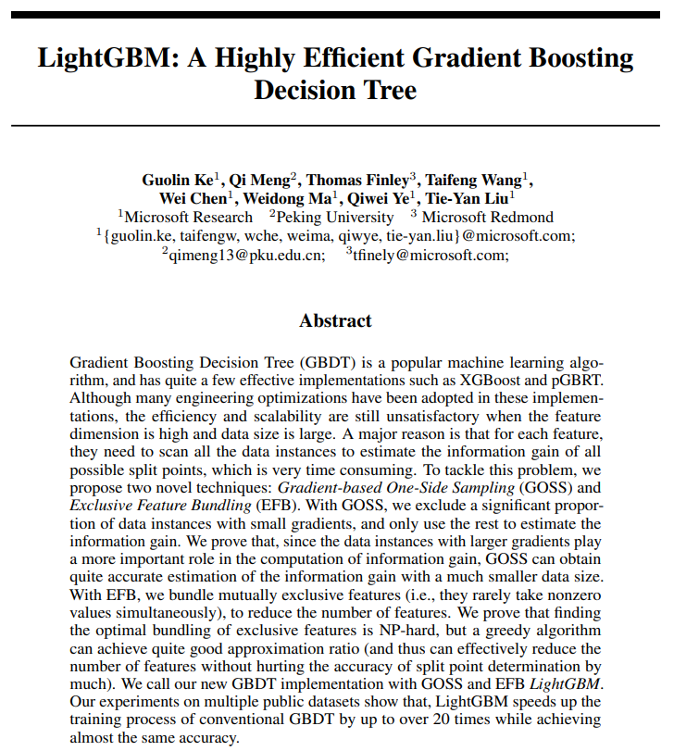
Light GBM (Light Gradient Boosting Machine)
Ke, Guolin, et al. "Lightgbm: A highly efficient gradient boosting decision tree." Advances in neural information processing systems. 2017.
https://github.com/Microsoft/LightGBM
Powerful algorithm with excellent performance in data analysis competitions such as Kaggle and Dacon
Tree-based ensemble of gradient boosting framework
Quickly learn from large data, take up less memory

Slide 4
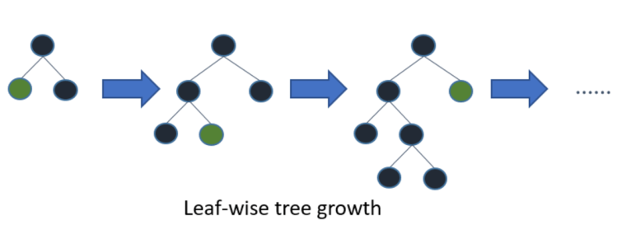
Light GBM
Leaf-wise
The original concept paper:
Shi, Haijian. Best-first decision tree learning. Diss. The University of Waikato, 2007.
XGBoost
To reduce the existing level-wise excessive operation
The tree is not balanced and the leaf nodes with max delta loss are split
Create asymmetric deep trees
When generating the same leaf, leaf-wise can reduce loss than level-wise
Light GBM

Slide 5
Two novel data sampling techniques for Light GBM
Gradient-based One-Side Sampling (GOSS)
: down sampling the data instances
: keep instances with large gradients (larger than a pre-defined threshold)
: randomly drop the instances with small gradients
→ more accurate gain estimation than uniformly random sampling
Exclusive Feature Bundling (EFB)
: In real applications, the feature spaces is sparse & many features are exclusive
: i.e., they rarely take nonzero values simultaneously (ex) one-hot features
: bundle such exclusive features by graph coloring and greedy algorithm
→ by taking features as vertices and adding edges for every two features if they are not mutually exclusive

Slide 6
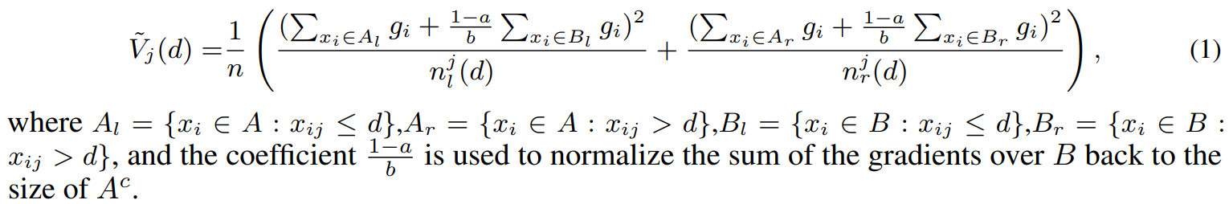
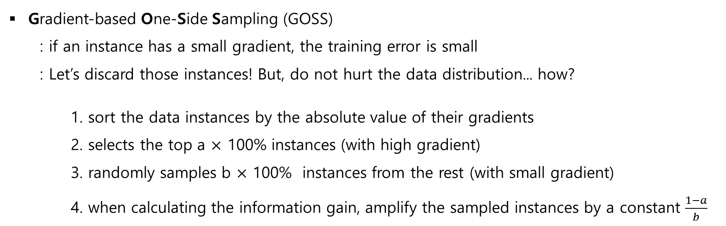
Gradient-based One-Side Sampling
Gradient-based One-Side Sampling (GOSS)
: if an instance has a small gradient, the training error is small
: Let’s discard those instances! But, do not hurt the data distribution... how?
1. sort the data instances by the absolute value of their gradients
2. selects the top a $×$ 100% instances (with high gradient)
3. randomly samples b $×$ 100% instances from the rest (with small gradient)
4. when calculating the information gain, amplify the sampled instances by a constant $\frac{1−a}{b}$

Slide 7
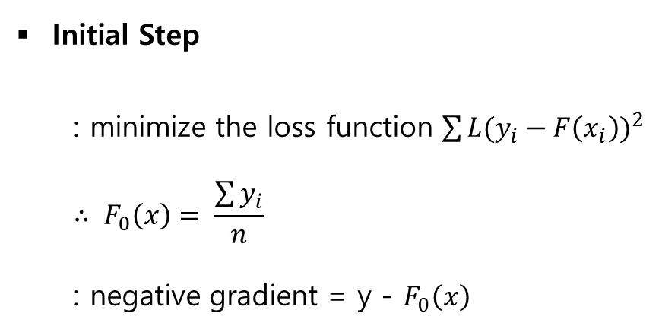
Example (a = 0.1, b = 0.1)
Initial Step
: minimize the loss function $\sum{{L(y_{i}−F\left(x_{i}\right))}^{2}}$
$$∴ F_{0}\left(x\right)= \frac{\sum{y_{i}}}{n}$$
: negative gradient = y - $F_{0}\left(x\right)$
Instance | f1 | ... | fn | y | F0 | y-F0
Instance1 | 10 | ... | 0.1 | 5 | 6 | -1
Instance2 | 11 | ... | 0.5 | 8 | 6 | 2
Instance3 | 15 | ... | 0.13 | 9 | 6 | 3
Instance4 | 14 | ... | 0.9 | 4 | 6 | -2
... | ... | ... | ... | ... | ... | ...
Instance99 | 13 | ... | 0.8 | 6 | 6 | 0
Instance100 | 9 | ... | 0.7 | 5 | 6 | -1

Slide 8
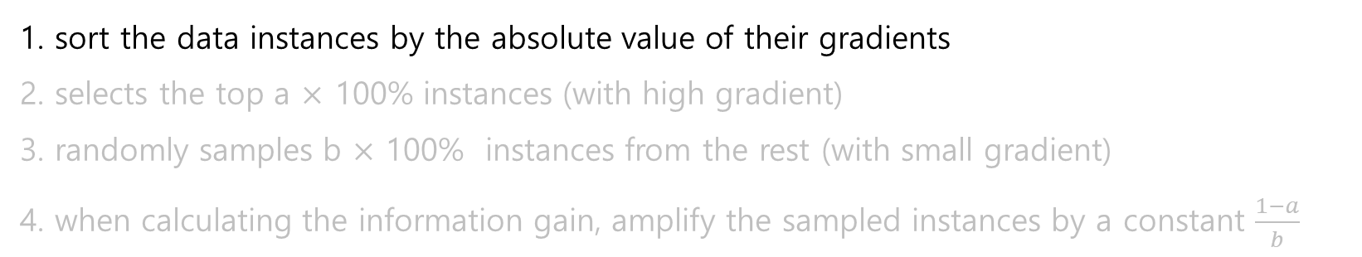
Example (a = 0.1, b = 0.1)
GOSS
Instance | f1 | ... | fn | y | F0 | y-F0
Instance1 | 10 | ... | 0.1 | 5 | 6 | -1
Instance2 | 11 | ... | 0.5 | 8 | 6 | 2
Instance3 | 15 | ... | 0.13 | 9 | 6 | 3
Instance4 | 14 | ... | 0.9 | 4 | 6 | -2
... | ... | ... | ... | ... | ... | ...
Instance99 | 13 | ... | 0.8 | 6 | 6 | 0
Instance100 | 9 | ... | 0.7 | 5 | 6 | -1
Instance | f1 | ... | fn | y | F0 | y-F0
Instance3 | 15 | ... | 0.13 | 9 | 6 | 3
Instance4 | 14 | ... | 0.9 | 4 | 6 | -2
Instance2 | 11 | ... | 0.5 | 8 | 6 | 2
... | ... | ... | ... | ... | ... | ...
Instance100 | 9 | ... | 0.7 | 5 | 6 | -1
Instance1 | 10 | ... | 0.1 | 5 | 6 | -1
Instance99 | 13 | ... | 0.8 | 6 | 6 | 0

Slide 9
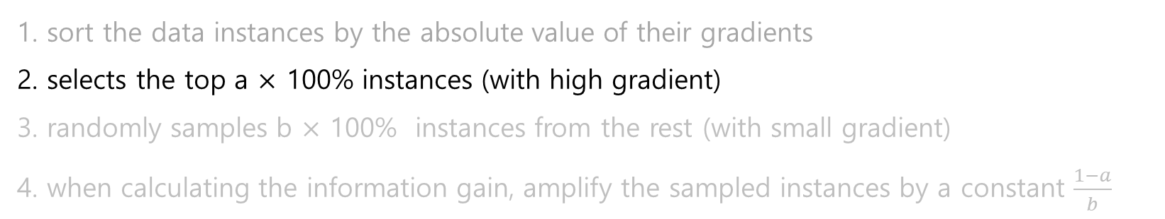
Example (a = 0.1, b = 0.1)
GOSS
Instance | f1 | ... | fn | y | F0 | y-F0
Instance3 | 15 | ... | 0.13 | 9 | 6 | 3
Instance4 | 14 | ... | 0.9 | 4 | 6 | -2
Instance2 | 11 | ... | 0.5 | 8 | 6 | 2
... | ... | ... | ... | ... | ... | ...
Instance100 | 9 | ... | 0.7 | 5 | 6 | -1
Instance1 | 10 | ... | 0.1 | 5 | 6 | -1
Instance99 | 13 | ... | 0.8 | 6 | 6 | 0
select top 10 intances → subset A
Instance | f1 | ... | fn | y | F0 | y-F0
Instance3 | 15 | ... | 0.13 | 9 | 6 | 3
Instance4 | 14 | ... | 0.9 | 4 | 6 | -2
... | ... | ... | ... | ... | ... | ...
Instance12 | 8 | ... | 0.25 | 4 | 6 | -2
Instance71 | 10 | ... | 0.8 | 7 | 6 | 1
10

Slide 10
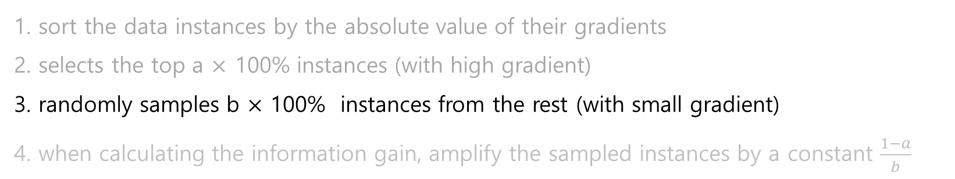
Example (a = 0.1, b = 0.1)
GOSS
Instance | f1 | ... | fn | y | F0 | y-F0
Instance2 | 11 | ... | 0.5 | 8 | 6 | 2
Instance100 | 9 | ... | 0.7 | 5 | 6 | -1
... | ... | ... | ... | ... | ... | ...
Instance99 | 13 | ... | 0.8 | 6 | 6 | 0
Instance45 | 14 | ... | 0.9 | 6 | 6 | 0
Instance31 | 15 | ... | 0.13 | 6 | 6 | 0
randomly sample 9 intances → subset B
Instance | f1 | ... | fn | y | F0 | y-F0
Instance99 | 13 | ... | 0.8 | 6 | 6 | 0
Instance100 | 9 | ... | 0.7 | 5 | 6 | -1
... | ... | ... | ... | ... | ... | ...
Instance45 | 14 | ... | 0.9 | 6 | 6 | 0
Instance31 | 15 | ... | 0.13 | 6 | 6 | 0
90
9

Slide 11
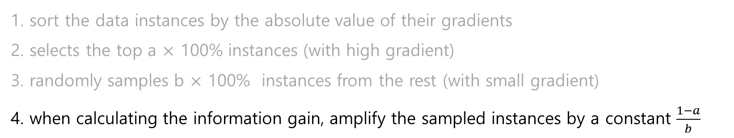
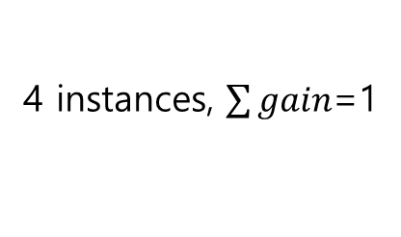
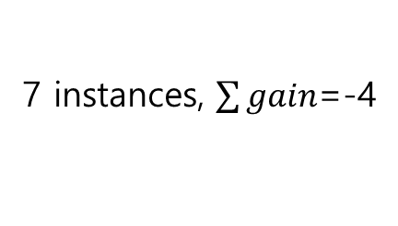
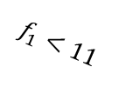
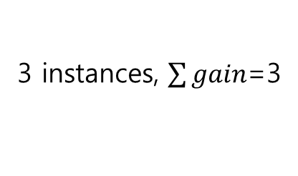


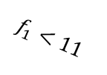
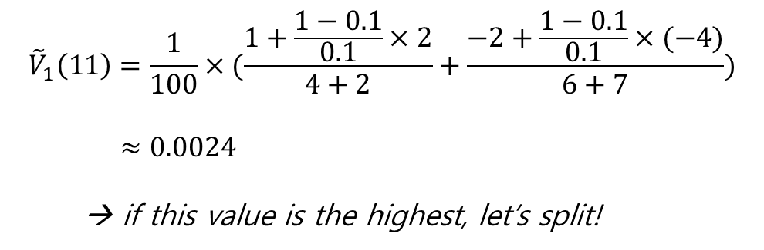

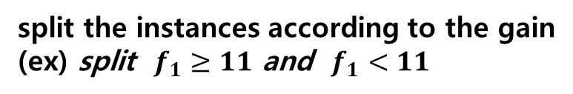
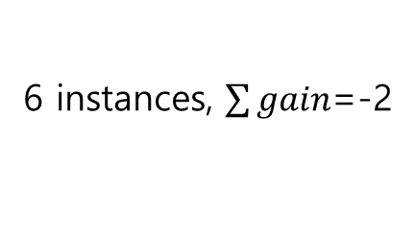
Example (a = 0.1, b = 0.1)
GOSS
subset A$∪$B
split the instances according to the gain
(ex) split $f_{1}≥11$ and $f_{1}<11$
Subset
A
$f_{1}≥11$
4 instances, $\sum{gain}$=1
$f_{1}<11$
6 instances, $\sum{gain}$=-2
$${\tilde{V}}_{1}\left(11\right)=\frac{1}{100}×(\frac{1+\frac{1−0.1}{0.1}×2}{4+2}+\frac{−2+\frac{1−0.1}{0.1}×(−4)}{6+7})$$
$≈0.0024$
→ if this value is the highest, let’s split!
Subset
B
$f_{1}≥11$
3 instances, $\sum{gain}$=3
$f_{1}<11$
7 instances, $\sum{gain}$=-4

Slide 12

Exclusive Feature Bundling
Exclusive Feature Bundling (EFB)
: to handle the sparse, high-dimensional data
: let’s bundle exclusive features into a single feature (bundle)!
Issue #1. which features should be bundled together?
NP-hard problem with complexity of O(#data$×$#feature)
it is impossible to find an exact solution within polynomial time
reduce the problem to the graph coloring problem and use greedy algorithm!
Greedy Bundling
Issue #2. how to construct the bundle?
merge the features in a bundle into one feature
→ Merge Exclusive Features

Slide 13
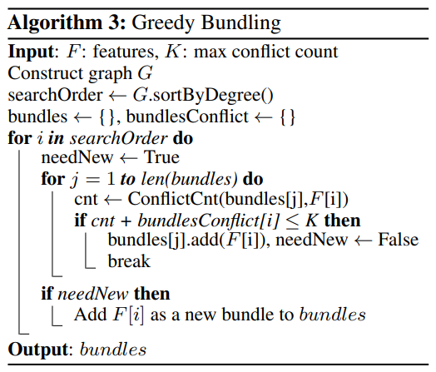
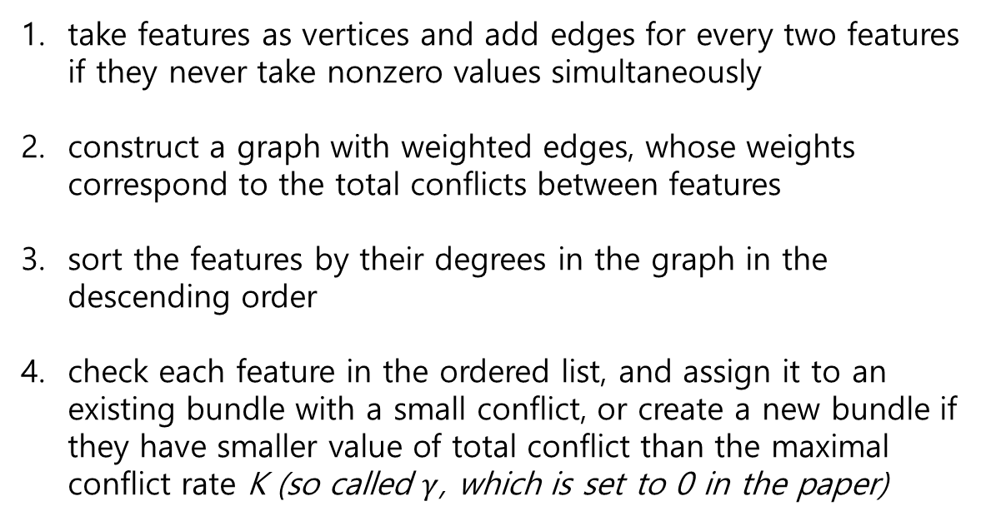
Exclusive Feature Bundling (1) Greedy Bundling
take features as vertices and add edges for every two features if they never take nonzero values simultaneously
construct a graph with weighted edges, whose weights correspond to the total conflicts between features
sort the features by their degrees in the graph in the descending order
check each feature in the ordered list, and assign it to an existing bundle with a small conflict, or create a new bundle if they have smaller value of total conflict than the maximal conflict rate K (so called $γ$, which is set to 0 in the paper)

Slide 14
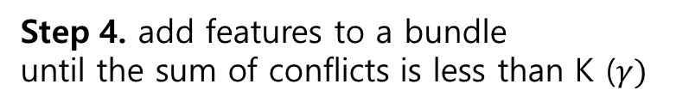
Exclusive Feature Bundling (1) Greedy Bundling
Step 1.
feature 1
Step 2.
feature 1
conflict
= 0
{0, 0, 0}
feature 4
{0, 0, 0}
feature 4
{0, 0, 1}
{0, 0, 1}
conflict
= 0
conflict
= 0
feature 2
feature 3
feature 2
feature 3
{0, 0, 2}
{0, 0, -1}
{0, 0, 2}
{0, 0, -1}
Step 3. order those by descending order
Step 4. add features to a bundle
until the sum of conflicts is less than K ($γ)$
Feature | conflict
feature 1, feature 2 | 0
feature 3, feature 1 | 0
feature 1, feature 4 | 0
feature 4
feature 1
feature 4
feature 1
feature 3
feature 4
feature 1
feature 3
feature 2
A bundle!

Slide 15
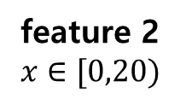
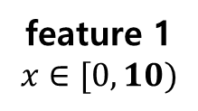
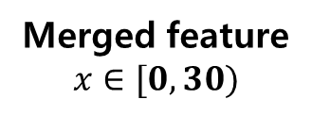
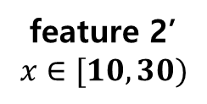
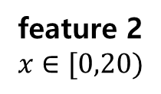
Exclusive Feature Bundling (2) Merge Exclusive Features
Add an offset of 10
to the values of feature 2
Merge into one feature
A bundle
Merged feature
$$x∈[0,30)$$
feature 1
$$x∈[0,10)$$
feature 2
$$x∈[0,20)$$
feature 2
$$x∈[0,20)$$
feature 2’
$$x∈[10,30)$$
NA
NA
NA
4
2
1
0
15
8
NA
NA
NA
0
15
8
NA
NA
NA
10
25
18
NA
NA
NA
NA
NA
NA
4
2
1
10
25
18
NA
NA
NA
10
25
18
4
2
1

Slide 16
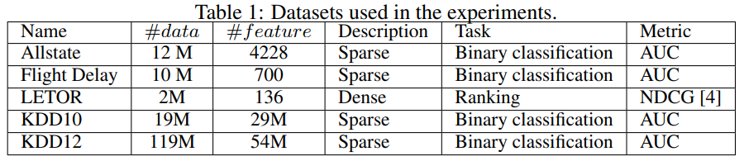
Experiment Results (1) Datasets & Benchmarks
Extremely high-dimensional big data about web search queries
Sparse data with a lot of one-hot coding features
xgb_exa (xgboost with pre-sorted algorithm)
xgb_his (xgboost with histogram-based algorithm)
lgb_baseline (GBM with leaf-wise tree growth strategy)
EFB_only (GBM with leaf-wise tree growth strategy & EFB)
SGB (GBM with leaf-wise tree growth strategy & stochastic gradient boosting
LightGBM (GBM with leaf-wise tree growth strategy & EFB & GOSS)
Benchmarks

Slide 17
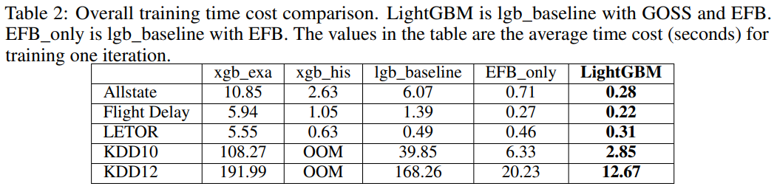
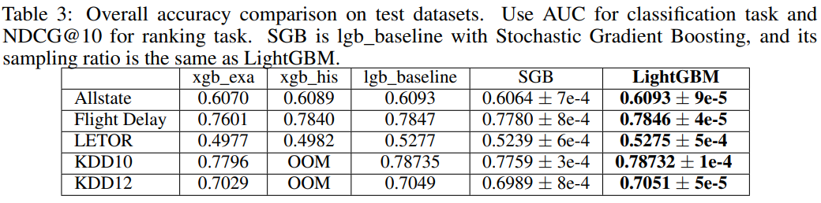
Experiment Results (2) Overall training time & accuracy

Slide 18
Conclusion
Light GBM is the fastest with the best accuracy
Light GBM outperform XGBosst and SGB in terms of computational speed and memory consumption
GOSS can bring nearly 2x speed-up by its own with using 10%-20% data
GOSS is always better than SGB when using the same sampling ratio
EFB can help achieve significant speed-up on those large-scale datasets

